Slide 1
Better Nutrition
for Better Breathing
Date:
Created by:

Slide 2
Objectives
Why nutrition is important for better breathing
How to choose a balanced variety of food
How to achieve a healthy body weight

Slide 3
Why nutrition matters
Breathe better
Lungs are working harder, so they need more fuel
Drinking plenty helps thin mucus, easier to cough up
Reducing salt can make breathing easier, by preventing the body holding on to water
Feel stronger
Helps retain muscle and bone mass
Fight infection
Fight inflammation
Notes:
Salt contains sodium
Too much sodium can cause your body to retain fluid making breathing difficult
Aim for less than 2300mg sodium per day (1 tsp salt). This may seem like a difficult and unknown goal to aim for however we will discuss ways which will help you reach this goal.
~75% of salt we comes from processed, packaged and takeaway foods
<number>

Slide 4
Variety is key
Choose foods from all four food groups:
Vegetables and fruit
Wholegrains
Milk & dairy products or dairy alternatives
Fish, eggs, poultry, meat, nuts, legumes and other meat alternatives
Notes:
<number>

Slide 5
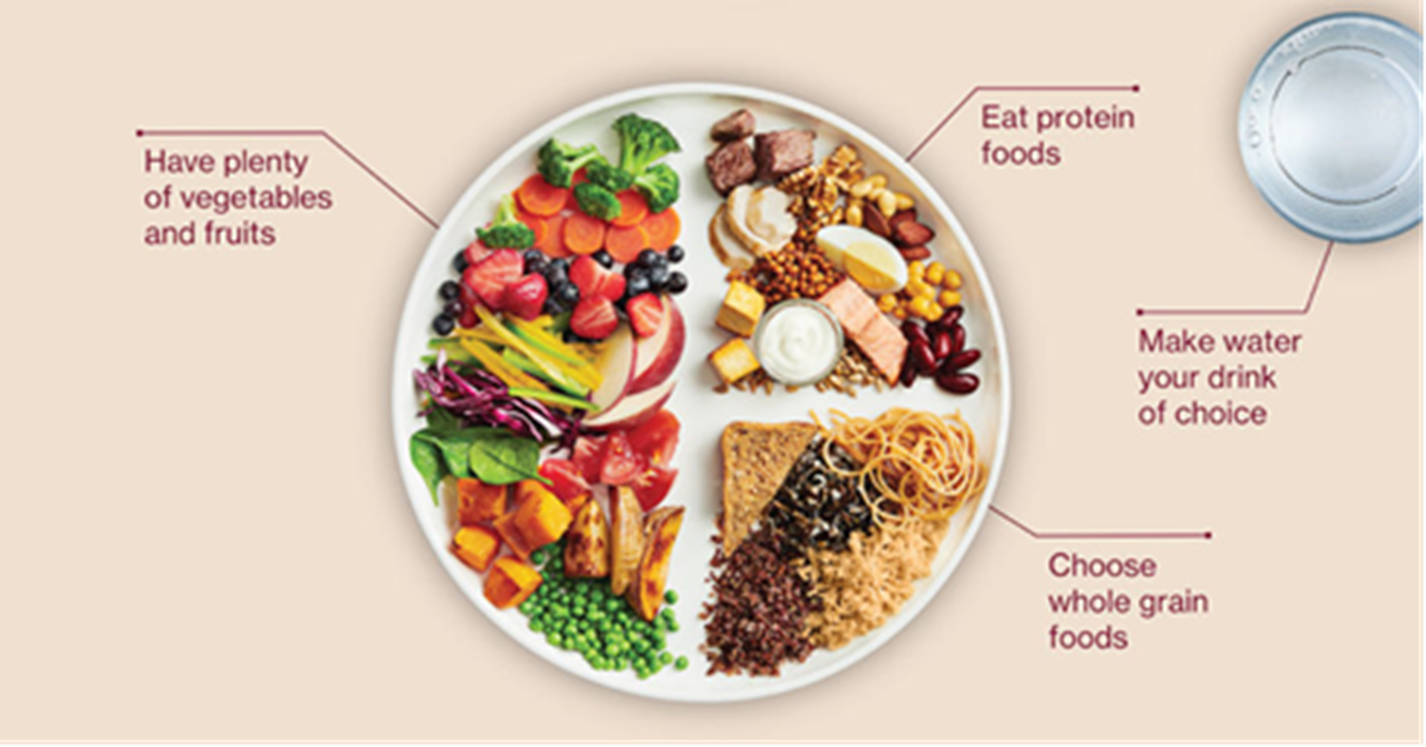
The plate model

Slide 6
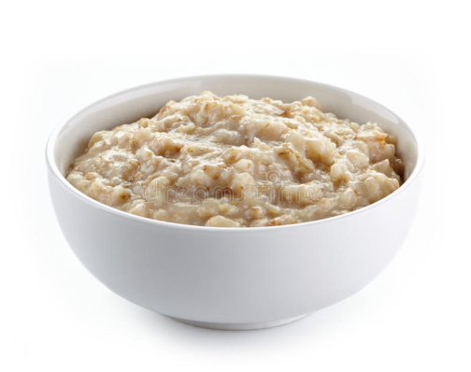
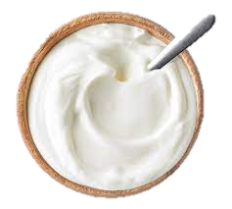
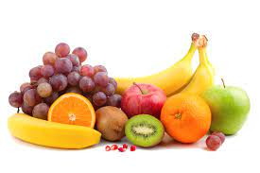
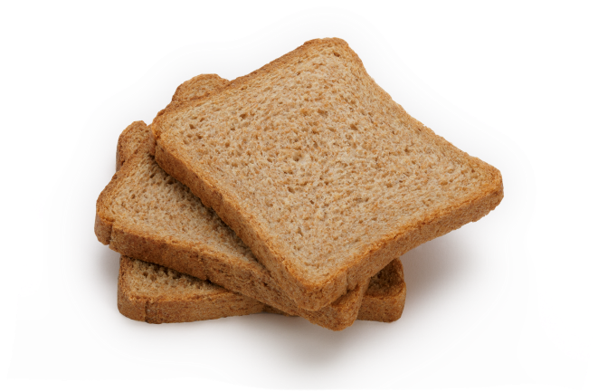
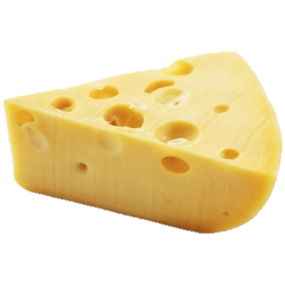
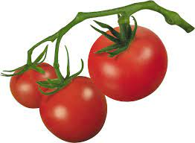
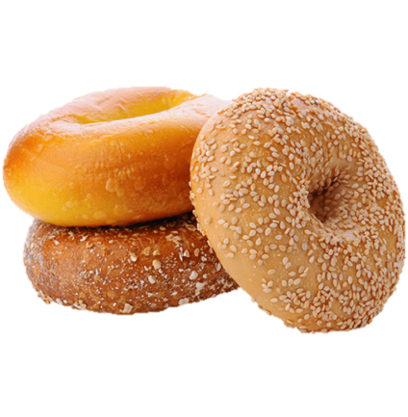
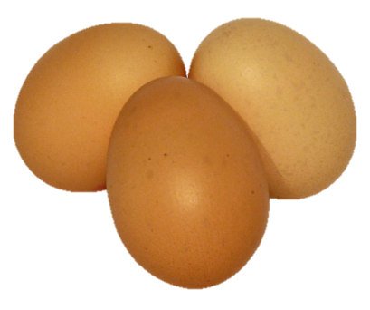
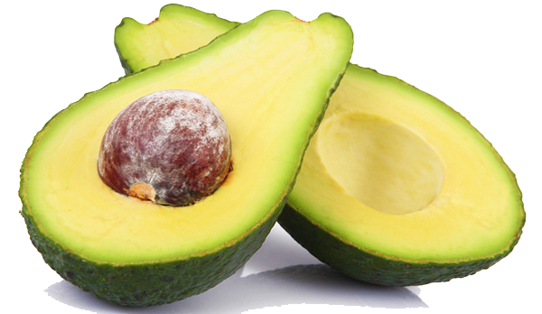

Quick & easy meal ideas - Breakfast

Slide 7

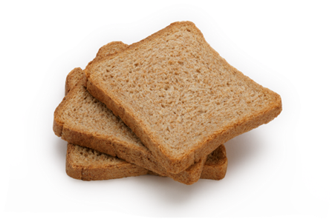
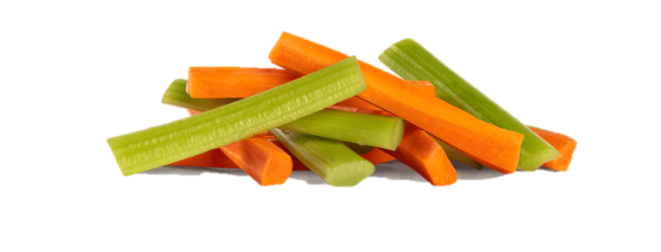
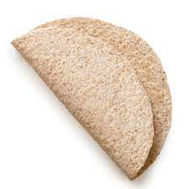
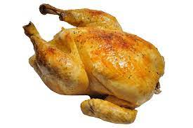
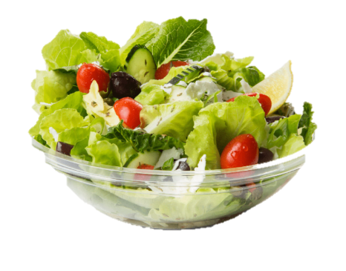
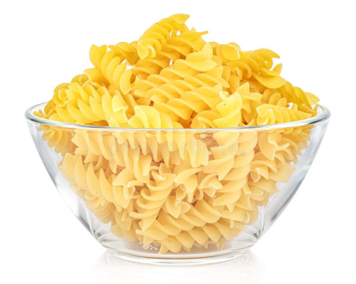
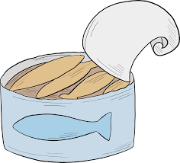
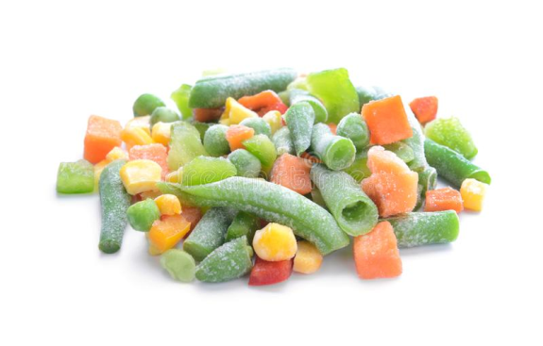
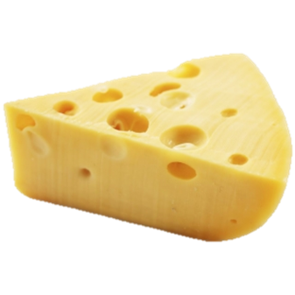
Lunch & Dinner

Slide 8
What about fat?
A balanced diet includes a small amount of good fats
Choose unsaturated fats over saturated fat
Examples?
Other ways to reduce saturated fat:
Choose lean meats or trim fat off meats
Limit processed meats (ham, bacon, salami) which can be higher in fat. OR grill these rather than fry
Grill, steam, microwave, boil or bake without adding extra fat
Notes:
Unsaturated: extra virgin olive oil, canola oil, sunflower oil, avocado, nuts, oily fish, seeds,
Saturated: butter, ghee, lard, fatty meats, fried foods and pastries etc
<number>

Slide 9
Tips to make eating healthy easier
Use tinned and frozen foods (especially vegetables)
Use a crockpot
Cook in bulk and freeze
Meal delivery services/ ready-to-eat meals
Eat with other people
Know your portion sizes

Slide 10






Portion sizes

Slide 11
Concerns if overweight
Heart and lungs must work harder, making breathing more difficult
Increases oxygen needs
Increased risk of developing other health problems
e.g. sleep apnea, diabetes, heart disease, cancer

Slide 12
Tips to slowly lose weight
Mindful eating
Eat slowly, notice when you are hungry and when you are full
Cook more often, as takeaways are often high in calories
Higher fibre foods help you feel full
Plate model includes half plate vegetables and fruit
Use hand portion sizes model as a guide
Vegetables = 2 hands, protein = palm, carbohydrate = fist
Move more. Aim for 30 minutes of activity per day.
Notes:
<number>

Slide 13
Concerns if underweight
May become weak and tired more often
May be more likely to get an infection
May weaken the muscles that control breathing
May experience decreased energy and movement

Slide 14
Causes of weight loss
Shortness of breath
Fatigue (too tired to cook)
Loss of appetite
Feeling bloated after eating
Food tastes different
Chewing and swallowing difficulties

Slide 15
Tips to gain weight
Small & frequent meals
Aim for 3 meals and 2-3 snacks throughout day
Nutrient-dense, high-calorie, high-protein
Add extra fat/oil, sauce, gravy, mayonnaise, cheese, nuts/seeds
May use commercial nutrition supplement drinks
Notes:
Drink liquids after a meal or between meals
Rest before and after meals
Eat your largest meal when you have the most energy
Choose full fat dairy products
Add extra energy and protein to your meals
<number>

Slide 16
Summary
Variety is key
Build a meal using the plate model
Know your portion sizes
Better nutrition leads to improved quality of life
Better breathing
Improved mobility and activity
Decreased risk of complications from having a low or high body weight
Decreased risk of infections which may mean less hospital admissions

Slide 17
Questions?

